Slide 1
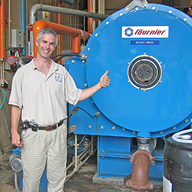
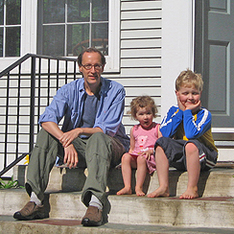
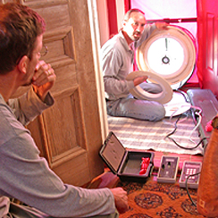
NEW APPROACHES FROM AN OLD UTILITY
Jim Merriam
Director
Efficiency Vermont

Slide 2
“Aren’t you done after CFLs?”
“Haven’t you already picked all of the low-hanging fruit?”
Notes:
Recently, I was at a utility board meeting, and got this question asked to me in a very sincere way. It was a good wake up call – that highlights, although we have done much work to transform the concept of energy efficiency in Vermont, we have much more work to do.

Slide 3
HOW THIS CAN BE ADDRESSED?
Being careful of your Marketing & Outreach
Examine how you deliver services
Consciously planning for the future – what steps are we taking
Notes:
Today I am going to talk about how we deliver our services and plan for the future to respond to this question.

Slide 4
KEY THEMES
20 year efficiency planning challenges us to rethink our short-term plans
Capitalizing on potential savings identified in the long-range plans requires new approaches
An aside of CAUTION - With new opportunities for deeper savings come increased risks
Notes:
In moving beyond characterizing efficiency’s future as limited to the low hanging fruit - the key themes I would like to touch on today are

Slide 5
EFFICIENCY VERMONT: OVERVIEW
Nation’s first statewide efficiency utility
The leading efficiency program in the U.S. – ranked #1 by ACEEE for the last five years
1.91% reduction in Vermont’s electricity supply requirements in 2011
11% of Vermont’s electric energy requirements met through efficiency as of 2011
Notes:
First some context with respect to efficiency Vermont’s maturity and harvest to date of low hanging fruit.

Slide 6
EFFICIENCY VERMONT: IMPACT
Notes:
Some additional context demonstrating our growing contribution to Vermont’s energy needs

Slide 7
EFFFICIENCY VERMONT: BUDGET
2012-2014 Budget: $133,480,191
Notes:
We track our savings to the Public service board by major reporting areas on this chart. Clearly the bulk of our savings come from business customers followed by efficient products. And our three year total budget is 133M, with approximately 12 M of that 3 year number directed to thermal efficiency.

Slide 8
EFFICIENCY VERMONT: EVOLUTION
Market Engagement
Programmatic Approaches
Prescriptive Approaches
VT Load Growth Turns Negative
(2007)
Order of Appointment
(2011)
Creation of EVT
(2000)
All Fuels Utility
(2008)
Notes:
Lastly for context – the timeline of Efficiency Vermont.On the bottom are the critical dates in the development/creation of EVT
On the top of the timeline is a progression of approaches Efficiency Vermont has deployed to serve ratepayers, and how these approaches have changed in reflection to adopting a longer view perspective to our planning.

Slide 9
PLANNING FOR THE FUTURE
As part of Efficiency Vermont’s Order of Appointment - required to file:
20 Year Demand Resources Plan (DRP) (scenarios)
3 Year Performance Period (adopted budget)
10 Year Thermal (based on funding expectations)
Notes:
DRP: Generate and analyze rate impacts and savings for different planning scenarios:
-Maximum Achievable requirements to capture all cost effective efficiency measures
-Flat and inflation adjusted constrained budgets for 20 years
-Ramp up to 3% depth of savings
The 20 year plan is evaluated at the statewide utility planning level to coordinate the benefits of efficiency with projected demand.
Based on Public Service board direction from the context of the 20 year DRP, a 3 year budgets and goals are set for Efficiency Vermont
In addition to our electric 3 and 20 year plans we also develop a 10 year thermal plan that due to the nature of funding, is set based upon expected funding. Because of the gap between current resources and maximum achievable potential, no alternate scenarios are constructed.

Slide 10
Notes:
This graph provides the context of our adopted Demand Resource Plan, against the economically Maximum Achievement savings.

Slide 11
MAXIMUM ACHIEVABLE OPPORTUNITIES
Residential Cumulative MWh Saved, by End Use
Notes:
Emphasis here is that the 20 year focus also informs our short-term priorities by highlighting where we need to move to obtain savings and bring value in the future. Clearly on the residential side a conscious focus on water heating and kitchen and laundry products would look appropriate to consider even on the shorter-term planning cycles in order to begin preparing.

Slide 12
MAXIMUM ACHIEVABLE SAVINGS
C&I Cumulative MWh Saved, by End Use
Notes:
Another aspect the max achievable savings potential highlights, is the greater variety of efficiency options available to the customer. To simply promote these options to our customers through traditional program rollouts without context and assistance to our customers would be overwhelming for them. Ultimately confusion on what to do next at the customer level is our greatest threat. This is where new approaches to serving our customer have taken hold at Efficiency vermont, and surprisingly are beginning to challenge some of our basic assumptions.

Slide 13
SO WHAT HAVE WE CHANGED?
How does EVT move towards supporting our customers when there will be efficiency options in the future.
RELATIONSHIPS – Creating a “partnership” with our customers that accelerates adoption of efficiency measures by focusing on delivering customer value
LEVERAGING THE MARKETPLACE – Using and consistently supporting the market to drive innovation and broaden the pace of adoption

Slide 14
RELATIONSHIPS = SAVINGS
Savings Potential
New Approaches
Programmatic Approaches
Prescriptive Approaches
Customer Engagement
Notes:
This slide crudely represents how are various approaches to the market and our customers translates into reaching our potential savings. Even without adopting the maximum acheivable Demand Resource Plan, we must adopt new approaches to reach our goals and keep the low hanging fruit coming.

Slide 15
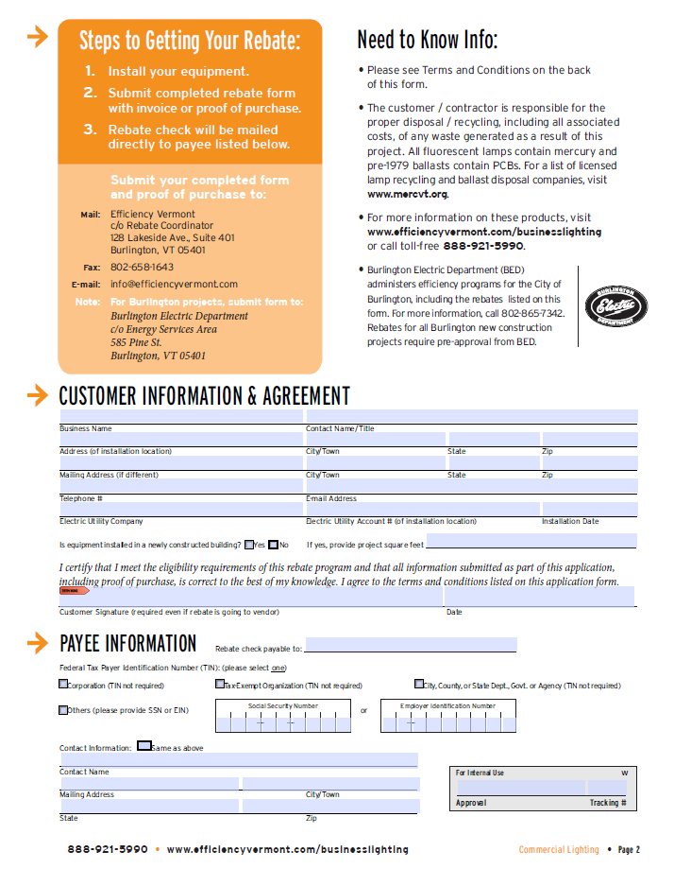
TRADITIONAL APPROACH
Prescriptive Rebate (hypothetical)
Provides a set incentive for the University of Vermont to upgrade equipment or lighting
Notes:
To put a finer point on this progression – I use a hypothetical approach (mostly) to how we may interface with the University of Vermont.
Here we are telling our customer how they can interact with us to meet our regulatory needs in an effort to provide service to our customers.
ADVANTAGE: Direct spending control. Still required to move markets that have insufficient resources to act
DISADVANTAGES: when limited funds are expended the programs end and the market cannot sustain itself

Slide 16
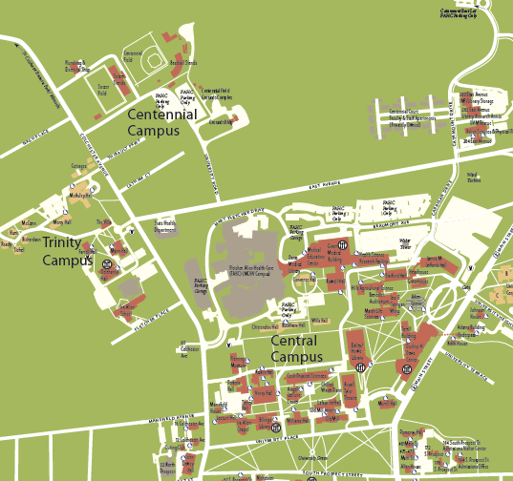
INTERIM APPROACHES
Programs
newLIGHT (hypothetical scenario)
University of Vermont worked with a program partner to evaluate their lighting needs on a campus-wide basis
They then qualified for enhanced rebates on fixtures that met program guidelines
Program was available for 6 months in 2011
Placeholder for picture
Notes:
In an interim step Efficiency Vermont has provided - Clear, low touch offerings for customers and the market to engage with efficiency.
Again however the Focus is on efficiency utility’s needs – please use our program offering - not the customers. If this is EFFICIENCY VERMONTSs focus, it can contribute to confusion for our customer’s on what to next if the choices become extensive – as they would need to be to capture the various efficiency technologies represented in the long-term planning.

Slide 17
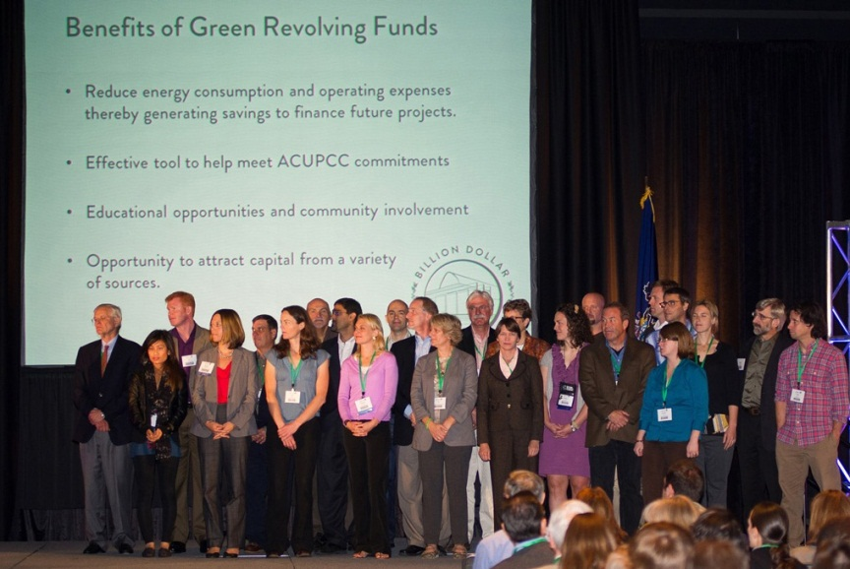
NEW APPROACHES
EMPHASIZING RELATIONSHIPS & CUSTOMER VALUE
Change customer perceptions of efficiency from a short-term opportunity to a long term investment strategy
Green Revolving Funds
The University of Vermont has committed $13M to establish the largest GRF in the US (not hypothetical)
Expecting commitments from a dozen Vermont colleges and Universities – the highest penetration of any state in the US
Notes:
ADVANTAGES: Deeper understanding of customer’s needs and planning cycles, moves both parties to efficiency as a long-term strategy versus a discrete project with a narrow payback, better opportunities exist for comprehensiveness and penetration. But most importantly it provides CONTEXT FOR ACTION.
But new approaches come with two quick asides I want to touch on -

Slide 18
IMPACT OF NEW APPROACHES
Maximum achievable penetration rates are the result of informed professional judgment about what’s possible with the most aggressive intervention strategies in each market.
Notes:
New Approaches have the potential to more easily demonstrate that the Max Achievable studies may significantly underestimate the potential cost effective savings.
As we have built deeper relationships with our customers, we have found new opportunities for savings that we never could have foreseen that can be demonstrated in this next slide

Slide 19
IMPACT OF NEW APPROACHES
Annual Max. Achievable Savings Potential HP T8 vs. Std. T8
Parameter | Description | Value | Cumulative Result
Building type/end use electric forecast | Electricity sales for interior lighting for offices | 100,000 MWh | 100,000 MWh
Applicability Factor | % of interior office lighting energy use from linear fluorescent fixtures | x 80% | 80,000 MWh
Feasibility Factor | % of linear fluorescent fixtures that could be replaced with HP T8 technology | x 100% | 80,000 MWh
Turnover Factor | % of existing office space that will naturally replace lighting as remodel in given year | x 6.7% (typical fixture life of 15 years) | 5,333 MWh
Savings Factor | % energy savings from shifting from standard T8 to HP T8 (weighted avg. for different number of lamps) | x 17% | 907 MWh
Net Penetration | The increase in penetration of HP T8 fixtures as a result of the efficiency initiative | x 10% | 90.7 MWh
Can be much higher with greater penetration through engagement
Notes:
You don’t need to pay attention to the full details here, but what is important to note is that after a rather rigorous market characterization, we apply a net penetration that is our best estimation. With better relationships – more opportunities – this may understate the potential.
We have seen with relationship and approaches such as the Green Revolving Fund and our Energy Leadership Challenge for businesses that we are able to affect the assumed penetration rate – and expand the potential of efficiency beyond our original predictions.
Ideally this will help build the case for the need for potentially more investment and support.

Slide 20
NEW APPROACHES = MORE RISK
Savings Potential
New Approaches
RISK
Interim Approaches
Traditional Approaches
Market Engagement
Notes:
My last aside I wanted to quickly touch on with respect to NEW APPROACHES - If we define risk as less immediate control of participation, then as we move towards relationships and leveraging the market place we introduce risk that can lead to longer time constants between over/under participation and corrections by the efficiency entity.
Said very simply – It can be challenging managing too much of a good thing.
But if the tolerance to allow some time to correct trends exists, then the opportunity for greater participation and realization of maximum potential savings is easier to realize.

Slide 21
CONCLUDING THOUGHTS
20 year plans with a longer perspective can significantly impact how we think about short-term plans
By building relationships focused on value –
new and deeper opportunities for efficiency can be realized
our maximum achievable studies may prove to be understating the potential of efficiency
As we move towards a mature market engagement model, tolerance for risk must grow

Slide 22
QUESTIONS?
Jim Merriam, Director
Efficiency Vermont
jmerriam@veic.org
(802) 540-7604

